Slide 1
Diffusion
Name
Date

Slide 2
About Me
Where I work
Job title
A little about me
Notes:
Hi, my name is __________________ and I work for ___________________ doing ____________________.
Introduce a little about yourself (Ex. You can share the town you live in, school you attended if local, highlight of the grade of the classroom you are in to make yourself relatable, something about your family, hobbies)
We will talk a little more about my career later.

Slide 3
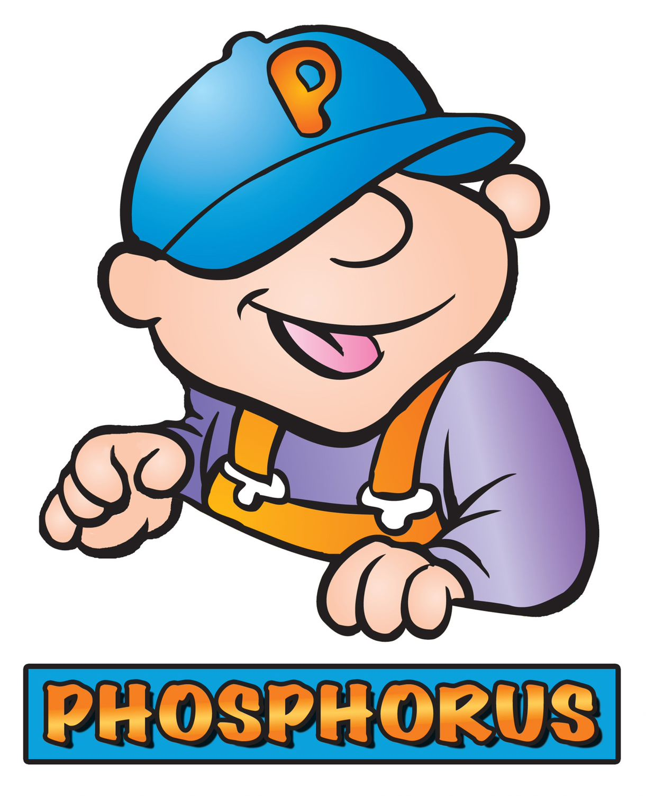
Notes:
Today we are going to talk about diffusion, but before we get to that, let’s talk a little about what plants need to grow and be healthy.
No matter what you grow, it needs the three primary nutrients N, P and K.
In science, we call nitrogen “N.” How do you think nitrogen helps plants? Plants need nitrogen to be green and healthy. Without nitrogen, plant leaves will be weak and yellow. Some plants require a lot of Nitrogen, so N is the first member of the NPK team.
The 2nd member of the team is P, which stands for Phosphorus. Without phosphorus the plant cannot conduct Photosynthesis. The leaves of a plant take in energy from the sun and turn it into energy for the plant. This is called photosynthesis. Phosphorus also helps encourage plants to grow strong and healthy roots, as well as helps the plant produce quality seeds, flowers, and fruit. Phosphorus can even help a plant resist disease, too.
Potassium, also called K, looks like a pink rock when it is mined. It’s mined either underground in the southeastern part of the United States or in the mountains in the northwest region. Potassium protects plants against diseases and helps the plants when it is cold or dry. It also helps the food you buy stay fresh.
How do farmers add these nutrients back to the soil if they are missing? Fertilizers! Every plant needs a specific amount of these nutrients, similar to a recipe when cooking. Some need more nitrogen, some need more phosphorus. Farmers send soil samples to agronomists, or a soil scientist, to find out how much fertilizer they need to add to their fields. They don’t want too little or their plants won’t grow well, and they don’t want too much because that could hurt their plants too. Farmers strive to be environmentally friendly, as well as economical.

Slide 4
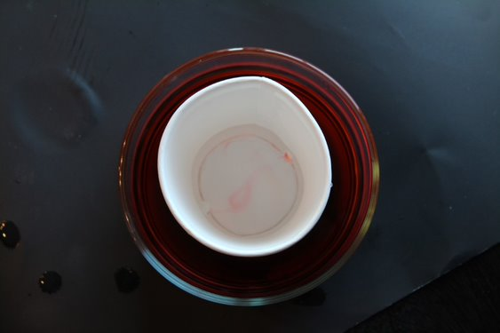
How do nutrients and water from the soil get into the root hairs?
Notes:
**What you will need for the diffusion lesson:
Visual Aids: Paper or disposable coffee cups, water, food coloring, larger container for the cup to sit in. Time: 10-15 minutes
Now that we have that background about NPK lets talk about how they reach the plant. Plants remove water and nutrients from the soil through the plant’s root system. Some nutrients move into root cells from the soil by diffusion and others by an energy-requiring process (active transport). Today we are going to do a diffusion activity which represents one way nutrients are moved into the plant by using a simple visual.
Ask students, “How do nutrients in the soil and water get into the plants root hairs?” Accept all answers at this time.
There are two ways water and nutrients move into a plants’ root system. One is active transport, and the other is diffusion. In diffusion, molecules move randomly due to their kinetic energy. This movement causes molecules to intermingle. The net movement of molecules is from an area of high concentration to one of lower concentration. The net movement stops when the concentration of the molecules is the same everywhere. The movement comes from their kinetic energy and does not need additional energy (unlike active transport).
You will notice that there is a high concentration of food coloring which represents the crop nutrients outside the cup. As the holes are punched, it allows the food coloring to enter into the area of low concentration aka the cup.

Slide 5
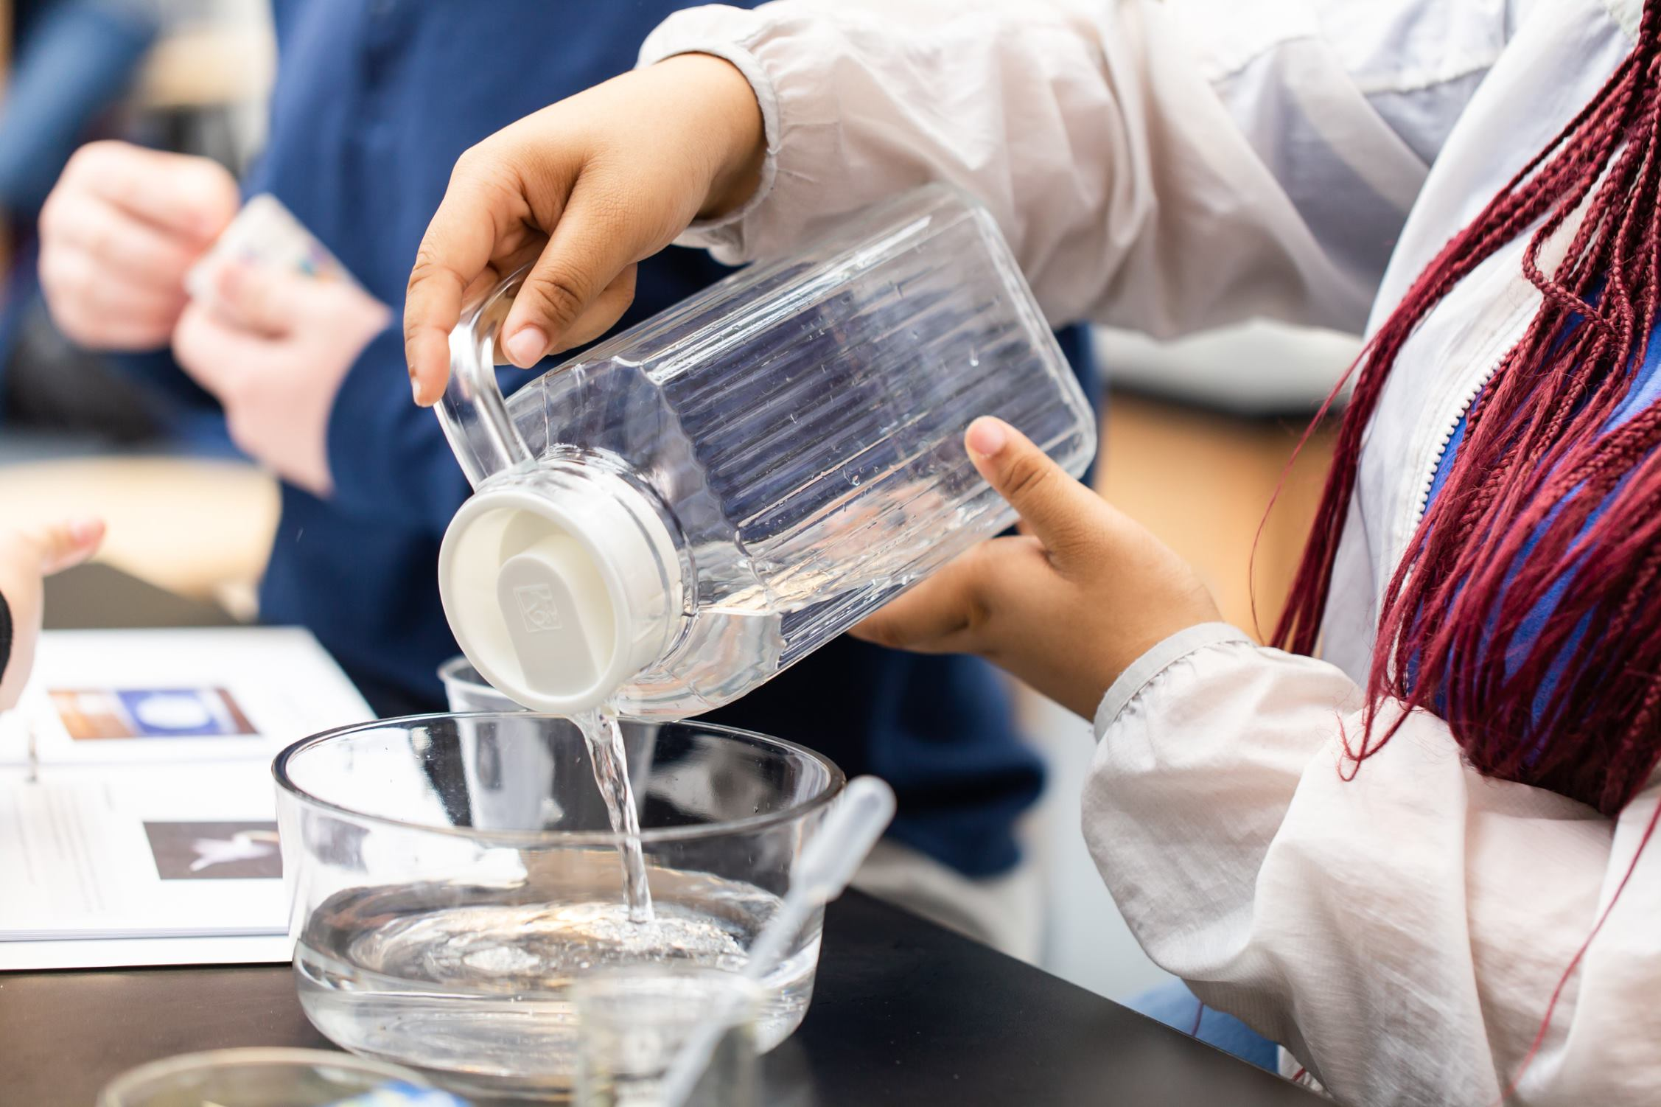
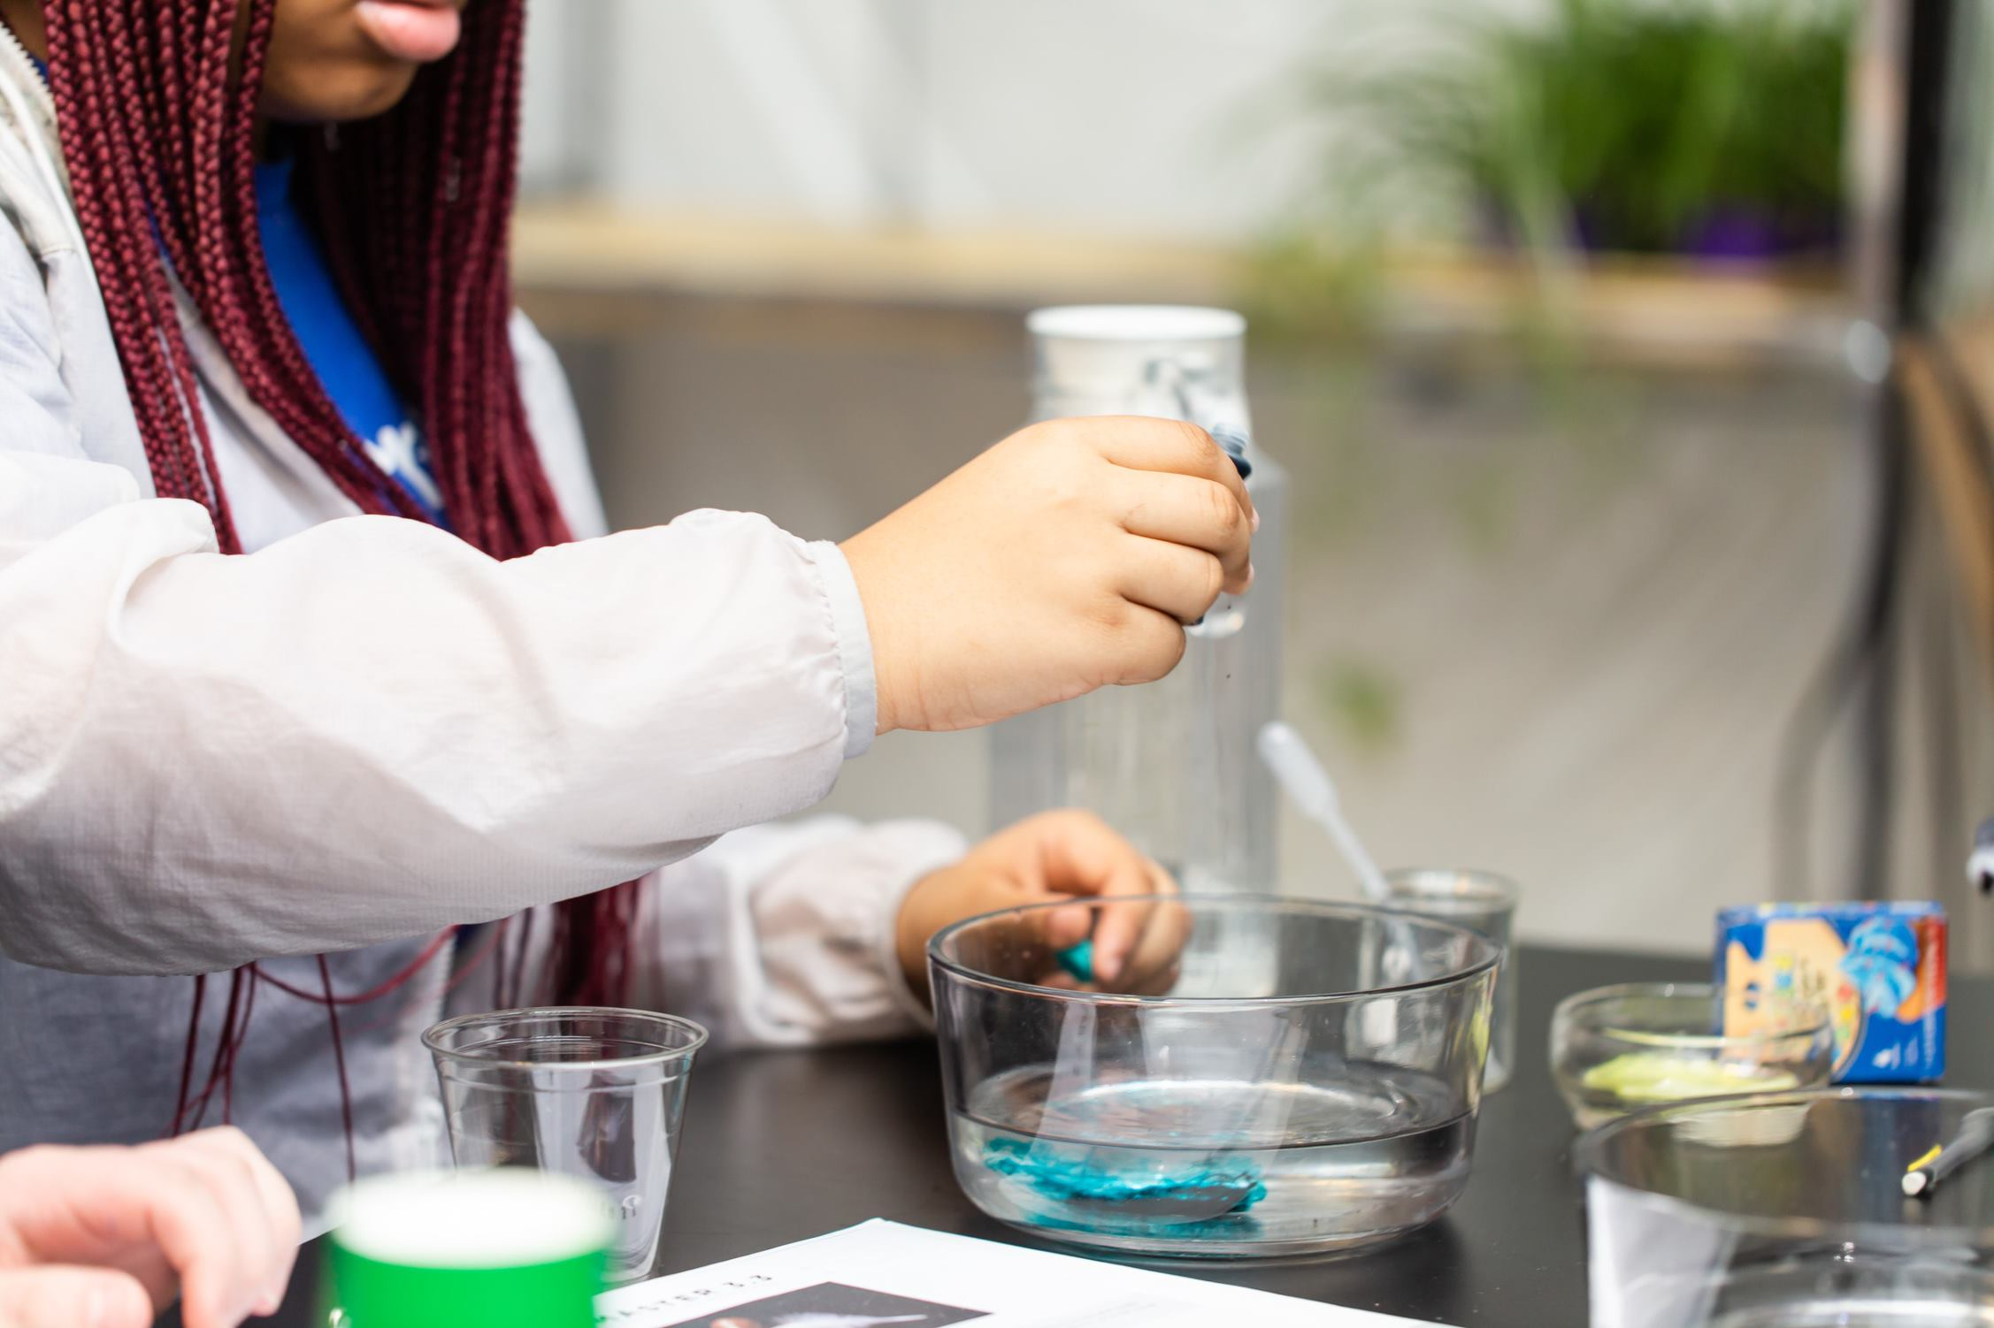
Notes:
Activity: You are now going to investigate the process by which water enters the root hair (Divide classroom into groups based on the number of materials you have).
**Pass out a container, water, food coloring and cup (with 2 holes opposite each other towards the base of the cup to each group). The water level in the larger container must be higher than the holes on the cup.
Fill the cup about ½ full of water. Have someone hold the holes on the cup closed.
Carefully place the cup of water into the center of the larger container.
As someone is still holding the holes on the cup, fill the larger container with the water until it is level with the amount of water placed into the cup.
Add several drops of food coloring to the water in the larger container and gently mix the water until the color is evenly distributed. Do not add coloring inside of the cup!
Poke 2 holes in the cup, opposite of each other.**
**You may find it easier to prep holes in the cups ahead of time. If doing so, pour the water in the larger container first. Then have one student hold the holes closed with their fingers, while another student pours water into the cup.
Watch the water in the cup for 5 minutes and record observations.

Slide 6
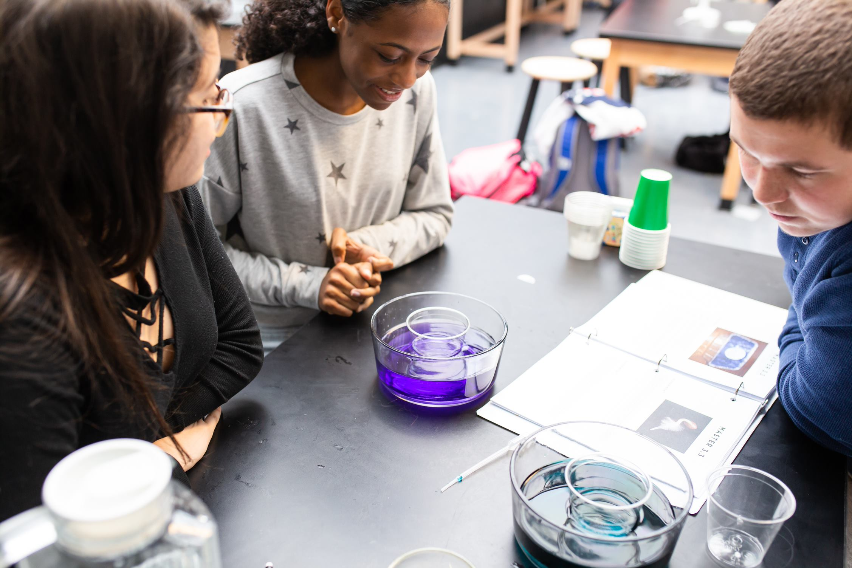
Review
Why did the colored water enter the cup?
True or False?
Plant roots have tiny hairs that absorb water.
Plant roots use energy to pump water into the plant.
Nutrients enter root ells through the process of diffusion.
Nutrients enter root cells through the process of active transport.
Plant roots grow until they find water.
Notes:
Review:
Ask students, “Why did the colored water enter the cup?”
Guide the discussion to bring out that although the concentration of water was the same on both sides of the cup, the concentration of the food coloring was higher outside of the cup compared to inside the cup.
Ask the students to determine if the following statements are true or false:
Plant Roots have tiny hairs that absorb water. (TRUE)
Plant roots use energy to pump water into the plant. (FALSE)
As shown in this experiment, water enters the root hairs by the passive process of diffusion. When root hairs contact the water, the water flows from a high concentration in the soil toward a lower concentration in the root cells.
Nutrients enter root cells through the process of diffusion. (TRUE)
Nutrients enter root cells through the process of active transport. (TRUE)
Plant roots grow until they find water. (False)
Roots can only grow where water is already present. As the surface of the soil dries out, roots near the surface may die while roots further down are in contact with water and can grow deeper.

Slide 7
Add some pictures of you doing your job/ the facility you work in.
Notes:
We talked a little earlier about my job title, but what is it that I actually do, and how does it relate to what we just learned about N, P, and K?
** Spend some time talking about your career, how it relates to Agriculture and the fertilizer industry. What do you do on a daily basis? What kind of education is needed to have a job like yours? Feel free to add additional slides and pictures to better explain your career.

Slide 8
QUEStionS?
Notes:
Ask students if they have any questions. You may also add contact information if you would like to be available to answer additional questions.

