Slide 1
Active Transport
Name
Date

Slide 2
About Me
Where I work
Job title
A little about me
Notes:
Hi, my name is __________________ and I work for ___________________ doing ____________________.
Introduce a little about yourself (Ex. You can share the town you live in, school you attended if local, highlight of the grade of the classroom you are in to make yourself relatable, something about your family, hobbies)
We will talk a little more about my career later.

Slide 3
Notes:
Today we are going to talk about active transport, but before we get to that, let’s talk a little about what plants need to grow and be healthy.
No matter what you grow, it needs the three primary nutrients N, P and K.
In science, we call nitrogen “N.” How do you think nitrogen helps plants? Plants need nitrogen to be green and healthy. Without nitrogen, plant leaves will be weak and yellow. Some plants require a lot of Nitrogen, so N is the first member of the NPK team.
The 2nd member of the team is P, which stands for Phosphorus. Without phosphorus the plant cannot conduct Photosynthesis. The leaves of a plant take in energy from the sun and turn it into energy for the plant. This is called photosynthesis. Phosphorus also helps encourage plants to grow strong and healthy roots, as well as helps the plant produce quality seeds, flowers, and fruit. Phosphorus can even help a plant resist disease, too.
Potassium, also called K, looks like a pink rock when it is mined. It’s mined either underground in the southeastern part of the United States or in the mountains in the northwest region. Potassium protects plants against diseases and helps the plants when it is cold or dry. It also helps the food you buy stay fresh.
How do farmers add these nutrients back to the soil if they are missing? Fertilizers! Every plant needs a specific amount of these nutrients, similar to a recipe when cooking. Some need more nitrogen, some need more phosphorus. Farmers send soil samples to agronomists, or a soil scientist, to find out how much fertilizer they need to add to their fields. They don’t want too little or their plants won’t grow well, and they don’t want too much because that could hurt their plants too. Farmers strive to be environmentally friendly, as well as economical.

Slide 4
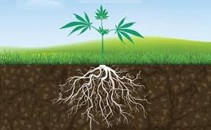
Plant and Soil Interactions
Plants move water and nutrients by diffusion or active transport.
How do water and nutrients get from the roots to the rest of the plant?
Active transport is the process used by cells to move molecules from an area of lower concentration to higher concentration.
Notes:
Visual Aids: Water glass, water, food coloring, and celery stalk. Prior to the demonstration cut the celery into pieces approximately 2 inches long. Make sure the surfaces are flat.
Time: 15-20 minutes
In order to understand how nutrients are transferred to a plant, you must first understand the interaction between the plants and the soil. Plants move water and nutrients through the root system either into the root cells from the soil by diffusion or by an energy-requiring process (active transport). Today we are going to do an activity demonstrating the transport of water through the xylem by using celery and food coloring.
Ask the students, “How does water and nutrients get from the roots to the rest of the plant?
Water and nutrients are moved throughout plants by active transport or transpiration.
Active transport is the process used by cells to move molecules from an area of lower concentration to one of higher concentration. It requires energy. The plant’s vascular system is similar to humans’ circulatory system. A plant has xylem and phloem, and we have veins and arteries. Veins go to the lungs to get oxygen, then the oxygen leaves the lungs, through the arteries to supply our bodies with oxygen. Plants transfer water from the roots to the rest of the plant through the xylem. Plants transport food from the leaves to the rest of the plant using the phloem. The xylem goes up and the phloem goes down.

Slide 5
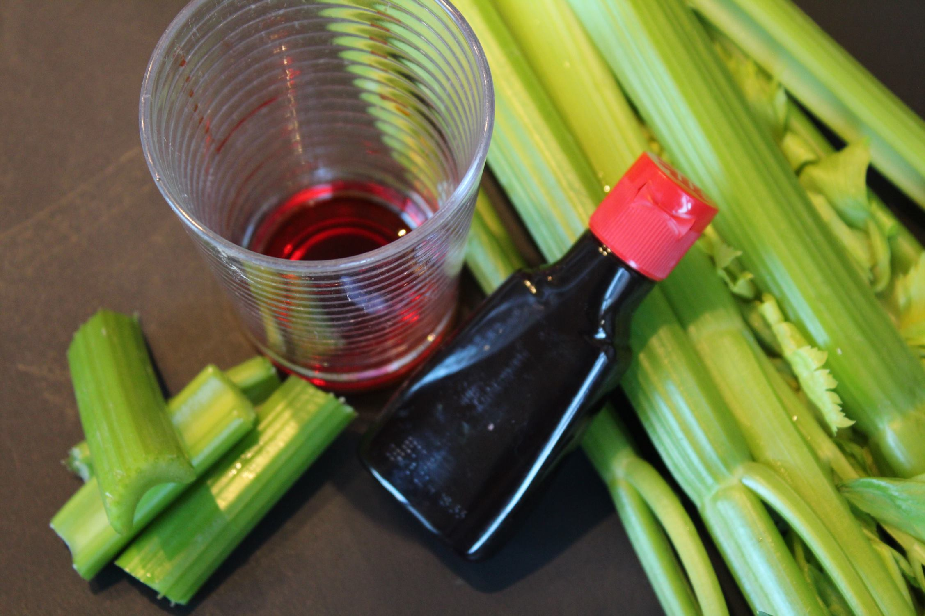
Activity
Pour 10 drops of food coloring into the cup, make sure it is enough to cover the base.
Place 2” piece of celery into cup of food coloring so it is resting on its cut surface.
Wait 10-15 minutes.
What do you think will happen with the food coloring?
Notes:
**Depending on the group size, you can do one demonstration or bring multiple supplies for students to break into groups.
Pour 10 drops of food coloring into the cup or enough to cover the base.
Place the 2” piece of celery stalk into the cup of food coloring so that it is resting on its cut surface. Let the celery stand undisturbed for 10-15 mins.
**Note: For a more dramatic result, bring in a celery stalk that was prepared the day before OR consider using a white carnation. If using a carnation, cut the stem diagonally so the stem is about 6 inches long. Allow it to sit for at least two hours. Small colored areas will appear at the edges of the petals.
What do you think will happen with the food coloring?
Check out this video: https://www.youtube.com/watch?v=PdQsvW7QjIM

Slide 6
Add some pictures of you doing your job/ the facility you work in.
Notes:
While we wait to see what happens with the celery we are going to shift gears and talk a little more about my career. We talked a little earlier about my job title, but what is it that I actually do, and how does it relate to what we just learned about N, P, and K?
** Spend some time talking about your career, how it relates to Agriculture and the fertilizer industry. What do you do on a daily basis? What kind of education is needed to have a job like yours? Feel free to add additional slides and pictures to better explain your career.

Slide 7
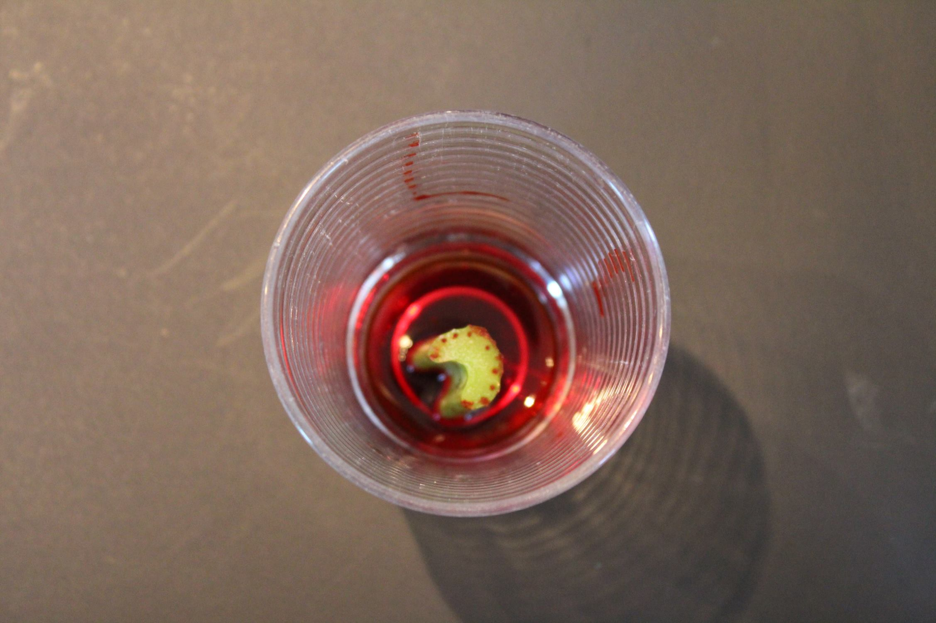
Review
What did you observe with the celery?
The hollow tubes are xylem
Notes:
After 10-15 minutes: What did you observe with the celery?
Notice the hollow tubes where you can see the food coloring, that is the xylem. Plants contain many xylem vessels stretching from the roots to the leaves.
Reiterate the importance of the nutrients being brought up into the plant and conclude the activity.

Slide 8
QUEStionS?
Notes:
Ask students if they have any questions. You may also add contact information if you would like to be available to answer additional questions.

